Slide 1
Game X
Team Members :1) Pritish Wadhwa - 2019440
2) Saarthak Gupta - 2019445
3) Meenal Gurbaxani - 2019434

Slide 2
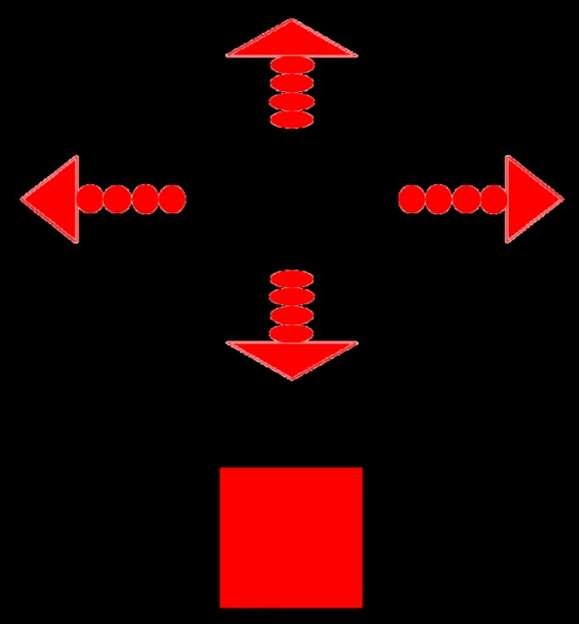

INSTRUCTIONS
CONTROLLERS : DOWN UP
RIGHT LEFT
SHOOT
OBJECTIVES : SINGLEPLAYER: To get to the centre of the maze using the
controls
MULTIPLAYER : To shoot the other players in an attempt to
be the only one to survive

Slide 3
CREDITS

